Slide 1
ATTENTION 101
- Ranraj Singh

Slide 2
Contents
Why traditional methods for sequence data are not good enough.
Idea behind Attention Mechanism and its advantages.
Attention in General and its variants.
Intuitive Understanding of Attention.
Simple implementation of attention.
Implementation on a public data set for text classification.
Other applications.

Slide 3
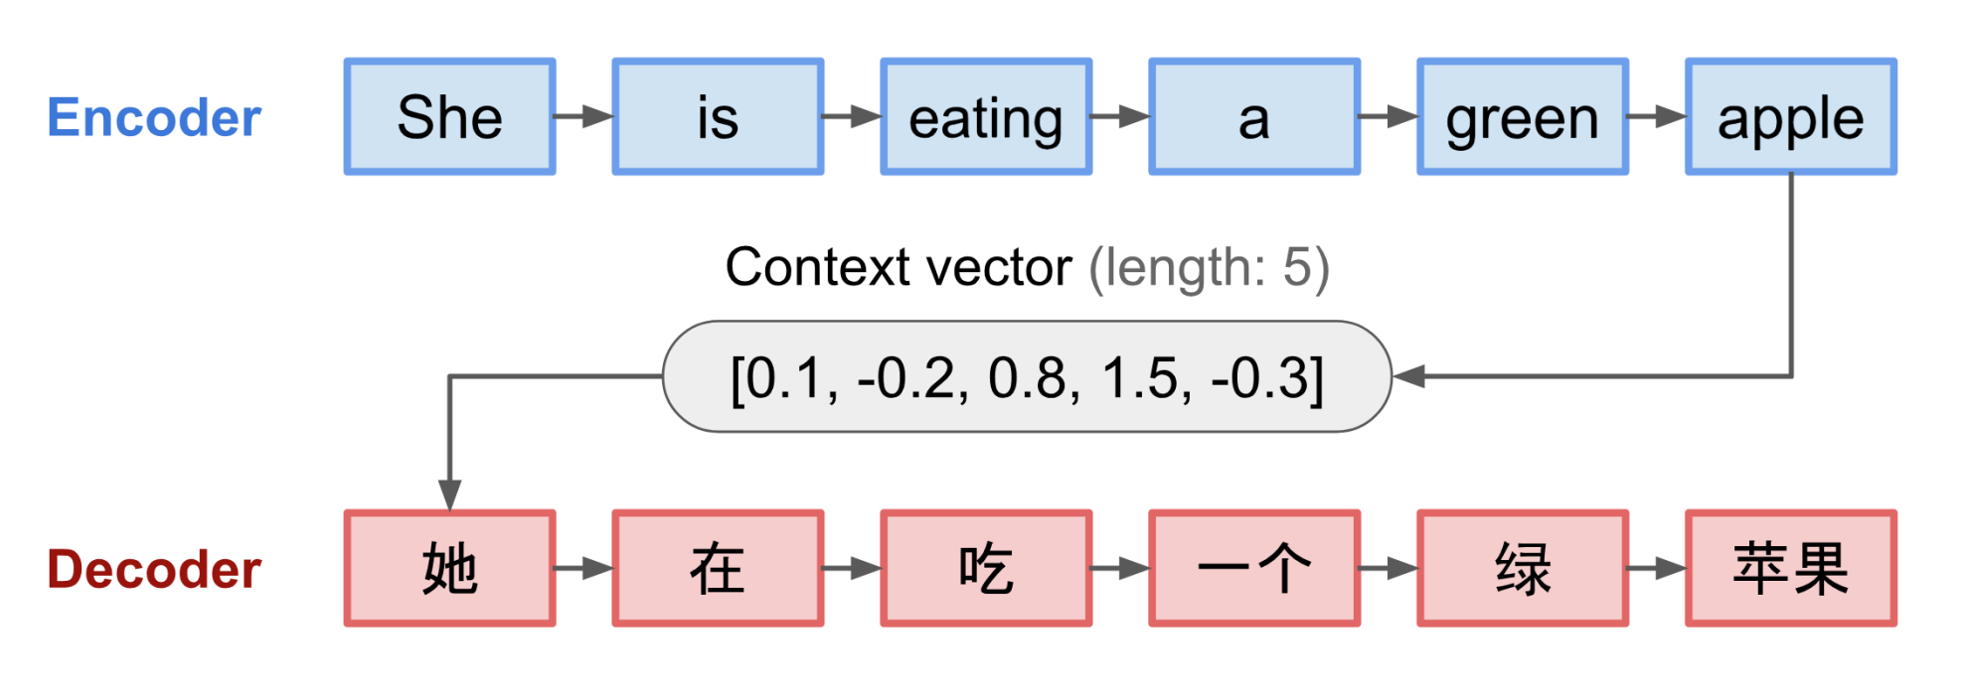
Why traditional methods for sequence data are not good enough?
An encoder processes the input sequence and compresses the information into a fixed length context vector.
A critical disadvantage of this design is its incapability of remembering long sentences. As it processes longer sentences it looses information about the beginning of the sentence

Slide 4
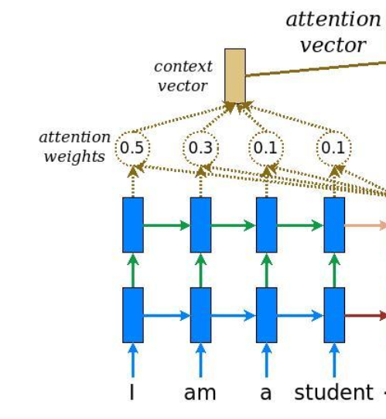
Attention: Idea
Rather than building the context vector out of the encoder’s last hidden state, the secret sauce invented by attention was to give context vector access to the entire input sequence.

Slide 5
Advantages
Attention Improves performance.
Attention provides some interpretability.
Helps with the vanishing gradient problem. (by providing shortcut to faraway states)
You don’t have to suffer the tradeoff between Accuracy and Interpretability.

Slide 6
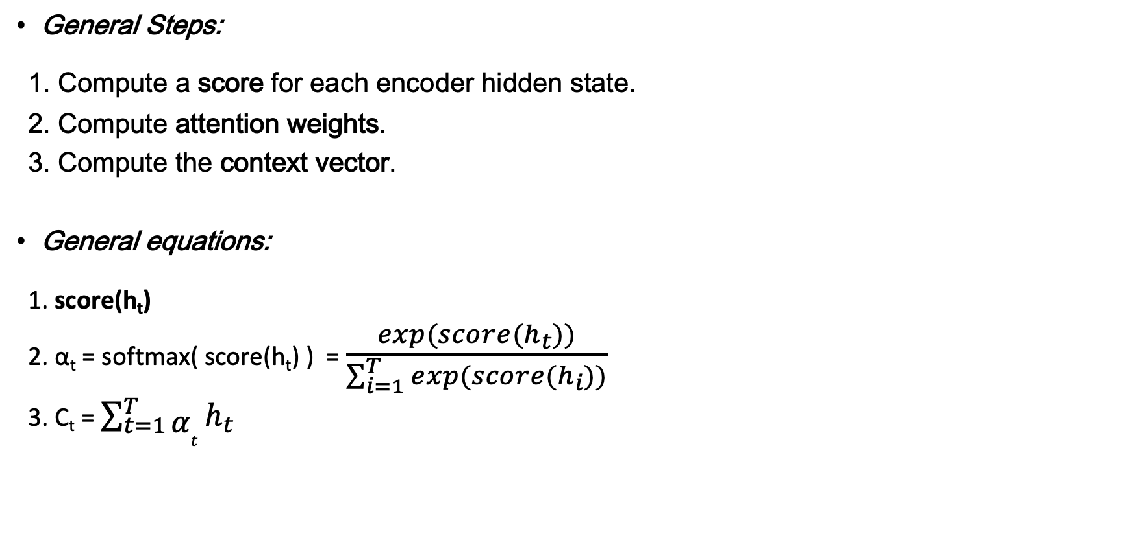
Attention in General
General Steps:
1. Compute a score for each encoder hidden state.
2. Compute attention weights.
3. Compute the context vector.
General equations:
1. score(h_{t})
2. α_{t} = softmax( score(h_{t}) ) = $\frac{exp(score(h_{t}))}{\sum_{i=1}^{T}{exp(score(h_{i}))}}$
3. C_{t} = $\sum_{t=1}^{T}{α_{t}}h_{t}$

Slide 7
Score function.
score(h_{t}) = v^{T} tanh(W h_{t})
Bahdanau 2015
1.
Some other score functions:
2.
3
where C_{t}=cell state of the last LSTM unit.
score(h_{t}) = v^{T} h_{t} (Luong 2015)
score(h_{t})= v^{T} tanh(W_{a}h_{t} +W_{b}C_{t})

Slide 8
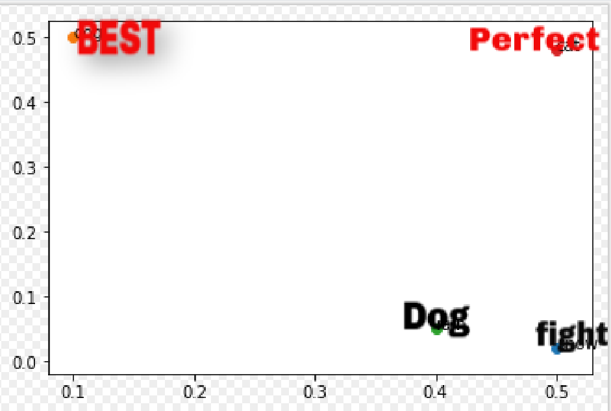
Intuitive understanding of Bahdanau attention
Lets understand with an example of sentiment analysis(Movie Reviews), where each word has a 2 dimensional embedding.
Ex: Our review contains these words: “Best dog movie ended with a perfect fight”
For the sake of simplicity lets only consider 4 words: best, perfect, dog, fight
score(h_{t}) = v^{T} tanh(W h_{t})
h_{t} for every word: Best=[0.5,0], Perfect=[0.5,0.5], Dog=[0.5,0.5],fight=[0.5,0]
1. u_{t} = tanh( W h_{t} )
This transforms the vector space. After transformation of the hidden states, u_{t} corresponding to each word looks like this.
u_{t} for every word: Best=[0,0.5], Perfect=[0.5,0.5], Dog=[0.4,0], fight=[0.5,0]
Now it is easy to pick impt words.
Lets take v=[0,1]

Slide 9
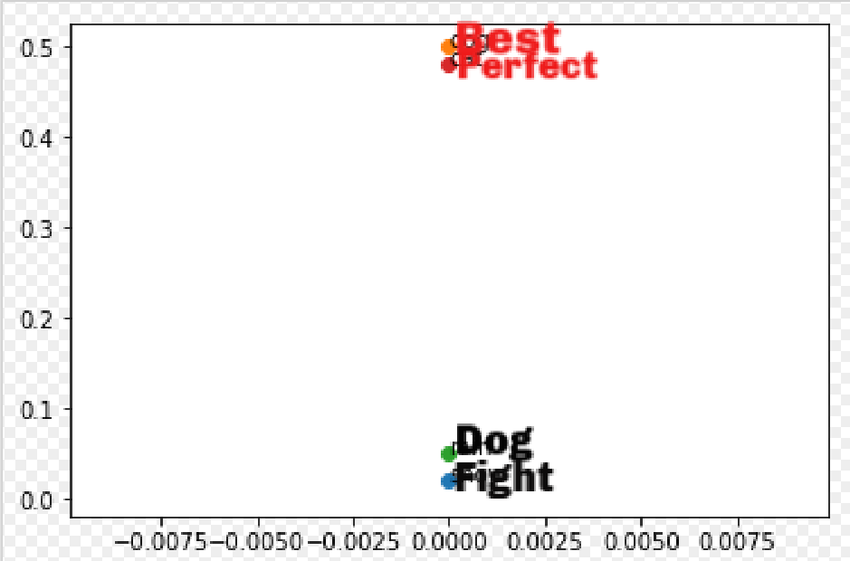
2. d_{t} = v^{T}u_{t}
Geometrically, v emphasizes the important dimensions of the vector space. It picks out the direction along which the variance is important.
Let V=[0,1], After V^{T}u_{t} The resulting score for each word will look like this:-
This means that the previous layer will move the input vector space around so that v can easily pick out the important words that have a decisive effect on the task at hand(Classifying reviews)

Slide 10

Implementing Bahadanu 2015 Attention in Keras
h_{t} =LSTM(units, return_sequence)
dim=(?,timesteps,units)
u_{t} = tanh( W h_{t} )
d_{t} = v^{T}u_{t}
α_{t} = softmax(d_{t})
C_{t} = $\sum_{t=1}^{T}{α_{t}}h_{t}$
U_{t}= Dense(units,’tanh’)
dim=(?,timesteps,units)
d_{t}= Dense(1, ‘linear’)
dim=(?,timesteps,1)
Flatten( )
dim=(?,timesteps)
RepeatVector(units)
dim=(?,units,timesteps)
α_{t} = Activation(‘softmax’)
dim=(?,timesteps)
att=Permute( [2,1] )
dim=(?,timesteps,units)
Multiply( [h_{t},att] )
dim=(?,timestep,units)
Context= Lambda(sum(axis=1) )
Output dim=(?, units)

Slide 11
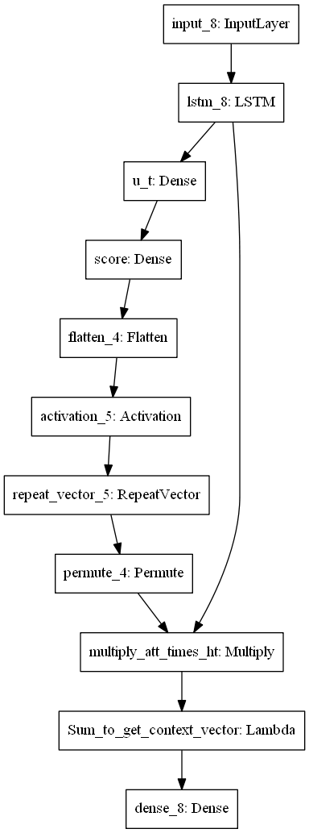
Attention Layer Architecture

